Slide 1


Natural catastrophe risk
Quantification for insurance and reinsurance
Andreas Schraft, Head Catastrophe Perils

Slide 2
Why insurers and reinsurers need catastrophe models

Slide 3
Premium
certain
Client
Insurer/Reinsurer
uncertain
loss payment
loss payment
saves capital
provides capital
Insurer/reinsurer needs to ensure that:
Premium equals expected loss plus margin.
Capital is sufficient to remain solvent after event.

Slide 4
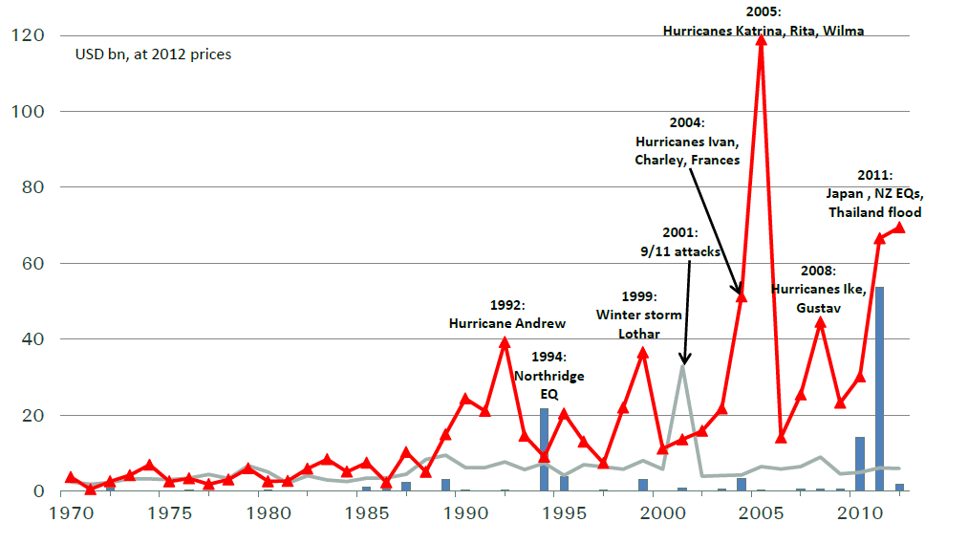
Insured catastrophe losses
1970–2012
Billion USD at 2011 values
Earthquake and tsunami
Fire and transportation
Storm and floods
Source: Swiss Re, sigma No 2/2013

Slide 5
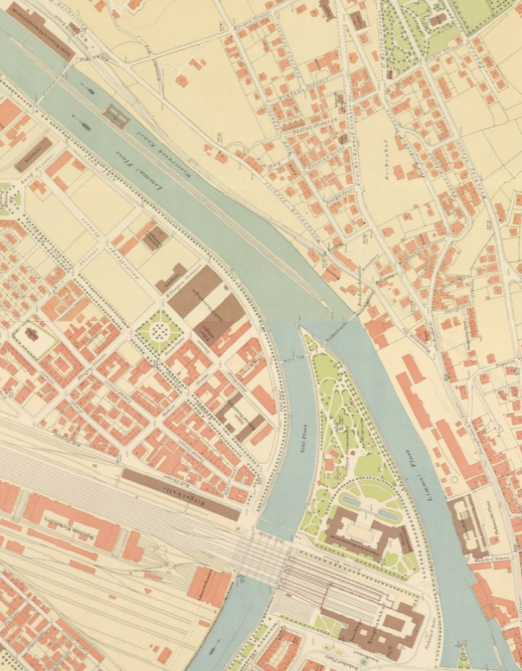
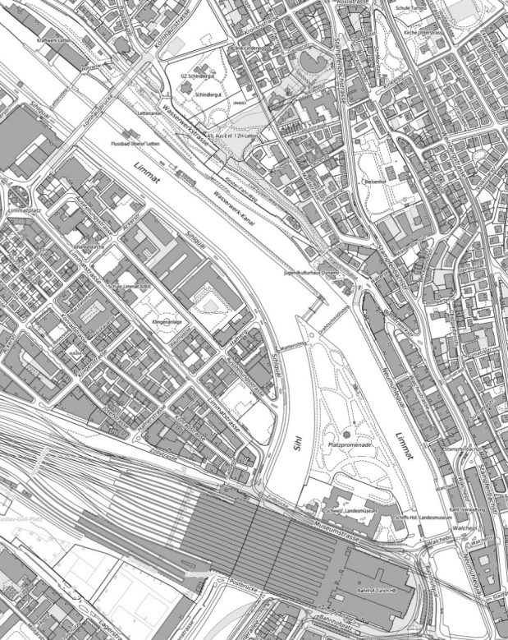
Growth of values is the main driver of increasing natural catastrophe losses
Zurich, around 1900
Zurich, 2013
Reasons
Increasing values
Concentration of values in exposed areas
Increasing vulnerability
Growing insurance penetration
Changing hazard (climate variability, climate change)
©Stadt Zürich
©Stadt Zürich
Loss history is not a good guide for risk, models are an indispensable tool.

Slide 6
How we model natural catastrophes

Slide 7
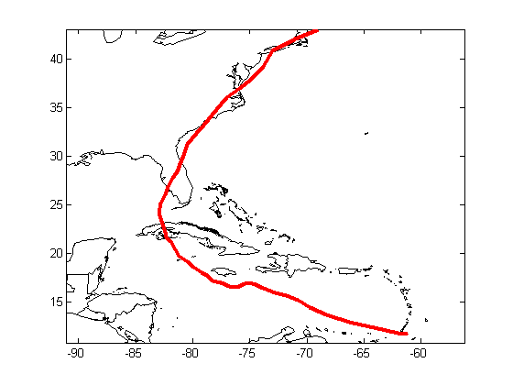
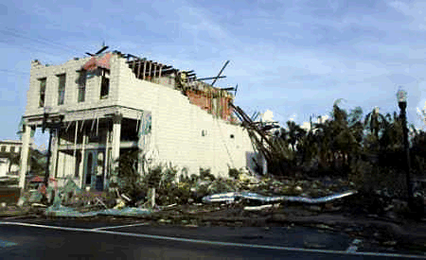
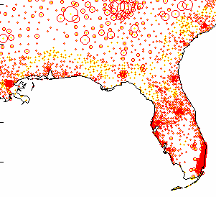
Four elements to model losses
Hazard
Vulnerability
Value distribution
Coverage conditions
How often? How strong?
How well built and protected?
What is covered?
Where? How?
Insurance sums
Limits
Excess
Exclusions
etc.
Example
Hurricane “Charley”
Aug 2004

Slide 8
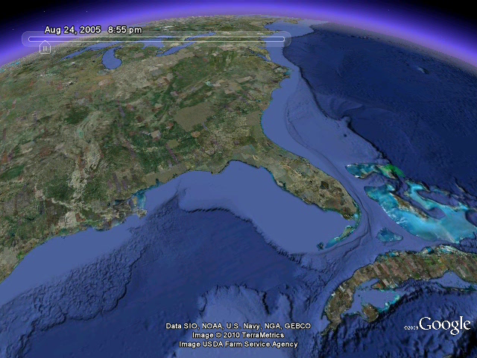
Simplest catastrophe model
Calculating a loss scenario
Hurricane
Kathrina 2005

Slide 9
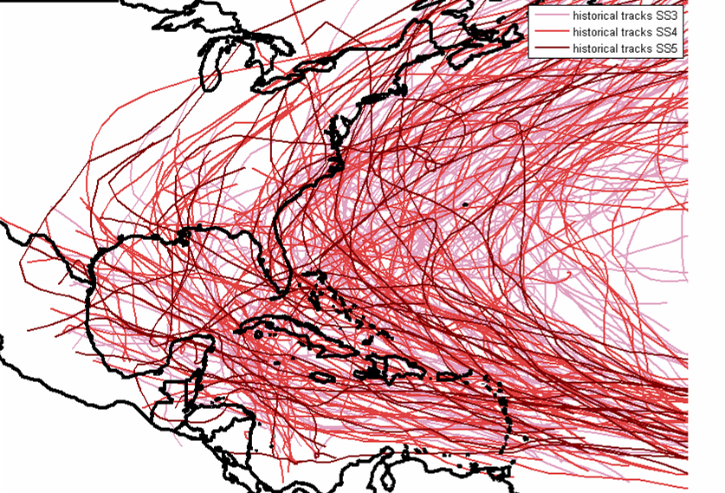
Tropical cyclones in the north Atlantic historical tracks
Historical
~100 years
~1’000 events

Slide 10
Tropical cyclones in the north Atlantic historical tracks
Historical
~100 years
~1’000 events

Slide 11

Tropical cyclones in the north Atlantic historical tracks
Historical
~100 years
~1’000 events

Slide 12
Tropical cyclones in the north Atlantic historical tracks
Historical
~100 years
~1’000 events
Even 100 years worth of historical events are not enough to fully reflect risk.

Slide 13
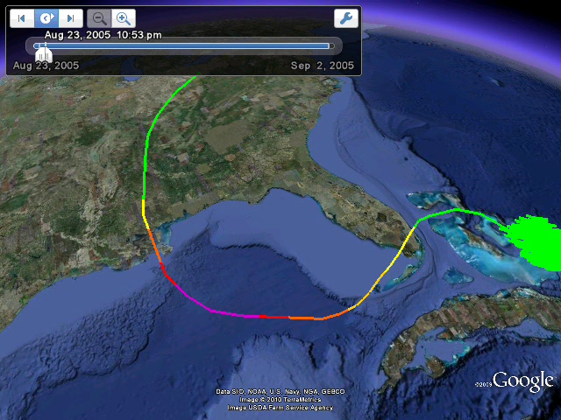
Creating additional events based on physical correlation
Hurricane Kathrina with daughter events

Slide 14
Tropical cyclones in the north Atlantic - historical and probabilistic tracks
historical
~100 years
~1’000 events

Slide 15
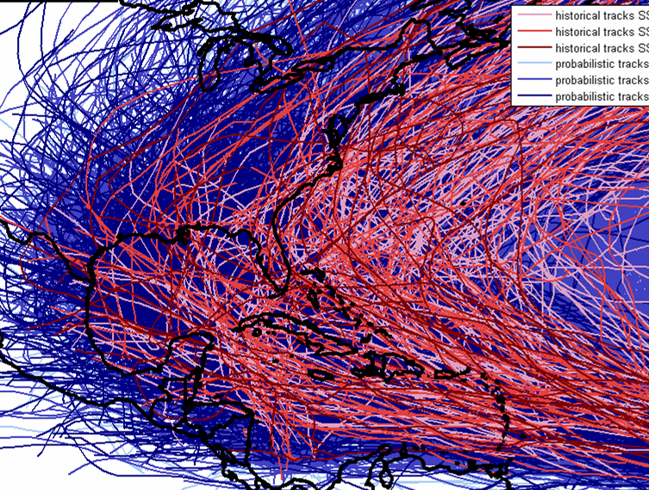
Tropical cyclones in the north Atlantic - historical and probabilistic tracks
historical
~100 years
~1’000 events
probabilistic
~20‘000 years

Slide 16
Tropical cyclones in the north Atlantic - historical and probabilistic tracks
historical
~100 years
~1’000 events
probabilistic
~20‘000 years
Probabilistic event set aims at reflecting full range of possible storms.

Slide 17
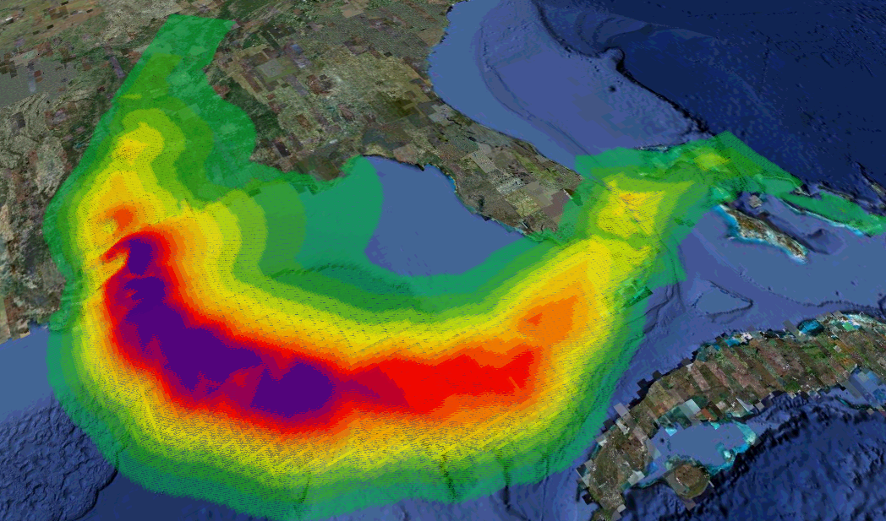
Hazard footprints
Hazard footprint: Maximum windspeed experienced by each point affected by a storm.
About 200'000 tropical cyclone footprints are prepared in the event / hazard database and used for ratings.
MultiSNAP v11 footprint of Katrina 2005
Notes:
17

Slide 18
Vulnerability
Wind damage depends on wind speed. Higher wind speeds lead to higher damage. However, loss data from storm events shows huge scatter.
Therefore, buildings need to be classified and described in detail, to be able to describe the behaviour in the model.
Classifications and descriptors we use include
  roof types, e.g. concrete tiles, clay tiles, single ply membrane, wood shingles, metal sheeting
  construction type
  number of storys
  occupancy, e.g. residential, commercial, healthcare

Slide 19
Four elements to model losses
Hazard
Vulnerability
Value distribution
Coverage conditions
How often? How strong?
How well built and protected?
What is covered?
Where? How?
Insurance sums
Limits
Excess
Exclusions
etc.
Example
Hurricane “Charley”
Aug 2004

Slide 20
Models are not perfect

Slide 21
Recent earthquakes in Chile, New Zealand and Japan
 | Chile 27 February 2010 | New Zealand 22 February 2011 | Japan 11 March 2011
Magnitude | 8.8 | 6.3 | 9.0
Energy released (compared to NZ) | 5 600 | 1 | >11 000
Fatalities/missing | 562 | >160 | >20 000
Economic loss, USD bn | 30 | 25 | 210
Insurance loss, USD bn | 8 | 9-12 | 30
Chile: Significant losses from industrial facilities, mainly due to business interruption
New Zealand: Back to back, relatively small events on a relatively low hazard zone, generating significant insurance losses, mainly due to liquefaction-related damage
Japan: Major damage and losses from tsunami; complications due to failure of nuclear power plants
Each of the earthquakes surprised us with a larger than anticipated loss.

Slide 22
Model blind spots revealed by recent earthquakes
Loss Driver | Modelled? | Pass?
Tsunami | Not as such. A few models/markets have a slight loading on the shock rates for coastal locations.
Increased seismicity after large event | Not modelled.
Liquefaction | Some models/markets consider liquefaction. However, all models by far underestimated impact in Christchurch.
Business interruption | Included in most models. However, impact for BI-sensitive industries generally underestimated.
Contingent business interruption | Not modelled. Exposure not fully understood.
Next surprise? | ?





Most vendor models have not yet taken into account experience from recent events.

Slide 23
Model blind spots revealed by recent earthquakes
Most (known) blind spots have been eliminated
Loss Driver | Modelled? | Pass?
Tsunami | Tsunami model for Japan in operation. Global model under development.
Increased seismicity after large event | Models are updated within weeks.
Liquefaction | Soil quality is part of all new earthquake models.
Business interruption | Vulnerabilities in earthquake adjusted globally.
Contingent business interruption | Not modelled. Addressed with underwriting measures.
Next surprise? | ?





Swiss Re is able to quickly learn from events and update models.

Slide 24
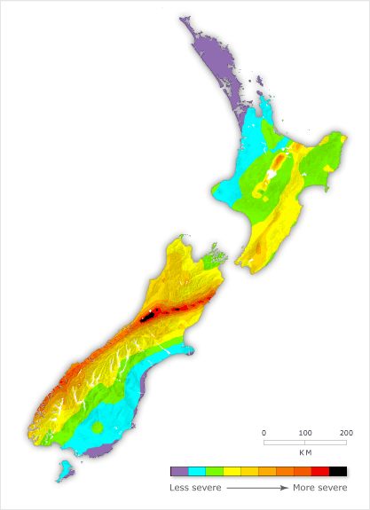
Historical Seismicity and Seismic Sources
Major Historical Events
  1855 M8.0-8.2 on Wairarapa Fault
  2011 M6.1-6.3 in Christchurch
  1931 M7.8-8.0 Hawke's Bay
Major Seismic Sources
  Wellington Fault: ~M7.8 every ~750 years
  Wairarapa Fault: ~M8.0 every ~1000 years
  Alpine Fault: ~M8.0 every ~250 years
Return Period of 2011 EQ (Loss)
  Observed: ~100yrs (considering seismic history)
  Estimated: ~300yrs (considering seismic sources)
Alpine Fault
Wellington and Wairarapa
Faults
Forming an opinion about risk is the starting point for building any model.

Slide 25
Earthquake New Zealand
Variation of earthquake model results
Modelled loss frequency curves for New Zealand market portfolio
Modeled Loss
0
100
200
300
400
500
600
700
800
900
Return period (years)
Differing opinions on earthquake risk in New Zealand.

Slide 26





Stay in touch
Andreas
Andreas_Schraft@swissre.com
+41 (0)43 285 2757
@ASchraft
Andreas Schraft
openminds.swissre.com

Slide 27
Legal notice
©2015 Swiss Re. All rights reserved. You are not permitted to create any modifications
or derivative works of this presentation or to use it for commercial or other public purposes
without the prior written permission of Swiss Re.
The information and opinions contained in the presentation are provided as at the date of
the presentation and are subject to change without notice. Although the information used
was taken from reliable sources, Swiss Re does not accept any responsibility for the accuracy
or comprehensiveness of the details given. All liability for the accuracy and completeness
thereof or for any damage or loss resulting from the use of the information contained in this
presentation is expressly excluded. Under no circumstances shall Swiss Re or its Group
companies be liable for any financial or consequential loss relating to this presentation.

