Slide 1



New “Risk-Targeted” Seismic Maps Introduced into USA Building Codes
Indian Institute of Science (IISc) Department of Civil Engineering Seminar
Nicolas Luco, Research Structural Engineer
U.S. Geological Survey
Golden, Colorado
Notes:
* I will treat “risk” and “performance” as synonyms.

Slide 2
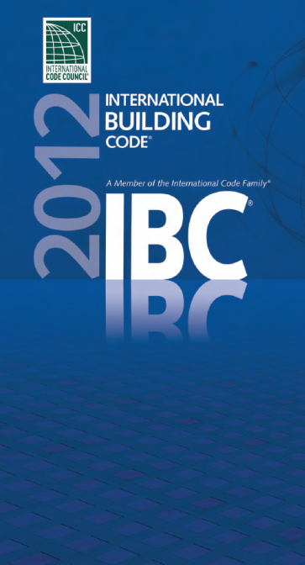

2012 “International” Building Code
FIGURE 1613.3.1 RISK-TARGETED MAXIMUM CONSIDERED EARTHQUAKE (MCE_{R}) GROUND MOTION …
Indian Institute of Science (IISc) Department of Civil Engineering Seminar
“New Risk-Targeted Seismic Maps Introduced into USA Building Codes,” N. Luco, USGS March 6, 2013

Slide 3
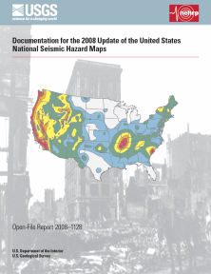
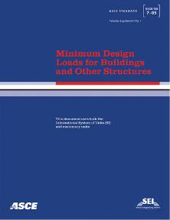
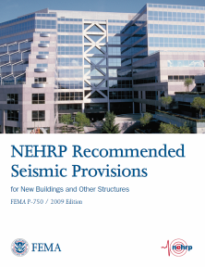

Development of MCE_{R} Maps
10
7-10
Indian Institute of Science (IISc) Department of Civil Engineering Seminar
“New Risk-Targeted Seismic Maps Introduced into USA Building Codes,” N. Luco, USGS March 6, 2013
Notes:
* Until recently, the engineering design of new structures to resist earthquakes, and the quantification of seismic risk for existing structures, had been relatively unconnected topics within earthquake engineering.

Slide 4
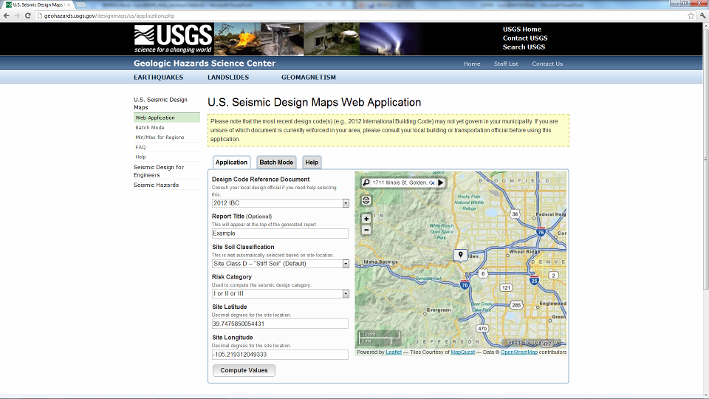
http://earthquake.usgs.gov/designmaps/usapp/
Indian Institute of Science (IISc) Department of Civil Engineering Seminar
“New Risk-Targeted Seismic Maps Introduced into USA Building Codes,” N. Luco, USGS March 6, 2013
Notes:
3 groups that I’m a part of

Slide 5
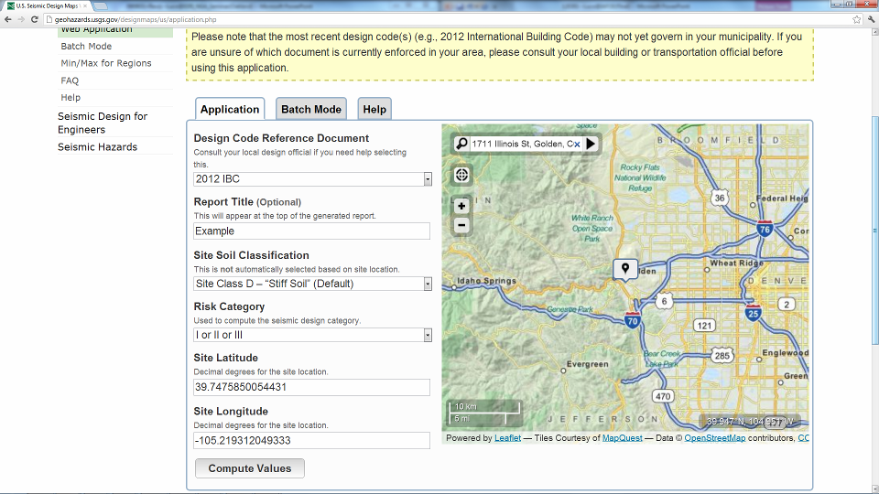
http://earthquake.usgs.gov/designmaps/usapp/
Indian Institute of Science (IISc) Department of Civil Engineering Seminar
“New Risk-Targeted Seismic Maps Introduced into USA Building Codes,” N. Luco, USGS March 6, 2013
Notes:
3 groups that I’m a part of

Slide 6
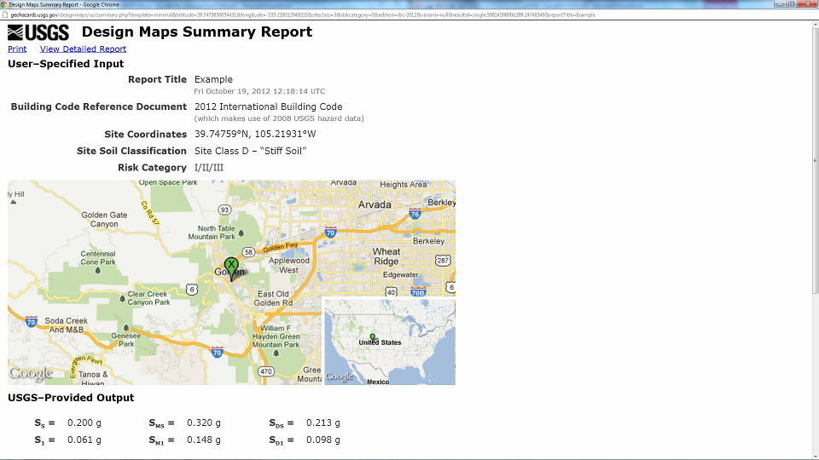
http://earthquake.usgs.gov/designmaps/usapp/
Indian Institute of Science (IISc) Department of Civil Engineering Seminar
“New Risk-Targeted Seismic Maps Introduced into USA Building Codes,” N. Luco, USGS March 6, 2013
Notes:
3 groups that I’m a part of

Slide 7
Outline of Presentation
Past/present design approaches for seismic safety
Quantification of seismic risk/performance
Recent/future risk-based seismic design approaches
Implications for designing against hazards, in general
Outstanding issues
Indian Institute of Science (IISc) Department of Civil Engineering Seminar
“New Risk-Targeted Seismic Maps Introduced into USA Building Codes,” N. Luco, USGS March 6, 2013

Slide 8
Past Seismic Design Approaches
Past and most present design approaches for seismic safety are prescriptive, based on following rules rather than explicitly quantifying performance/risk.
e.g., “If at least seven ground motions [(time series)] are analyzed, the design member forces … are permitted to be taken … as the average of the … values determined from the [building response] analyses …” – ASCE 7 Standard
For earthquake loads/demands, past (and most present) approaches typically design against …
Indian Institute of Science (IISc) Department of Civil Engineering Seminar
“New Risk-Targeted Seismic Maps Introduced into USA Building Codes,” N. Luco, USGS March 6, 2013

Slide 9
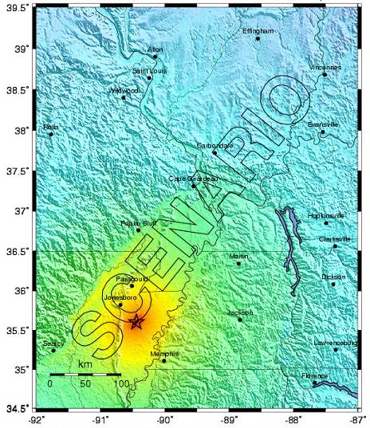
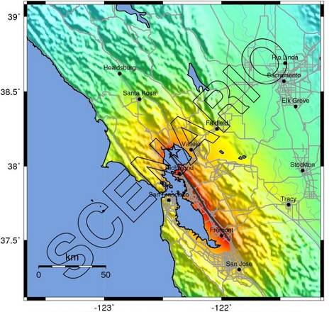
Deterministic Earthquake Scenarios
e.g., USGS “ShakeMaps”
Indian Institute of Science (IISc) Department of Civil Engineering Seminar
“New Risk-Targeted Seismic Maps Introduced into USA Building Codes,” N. Luco, USGS March 6, 2013
Notes:
… and the ground motion intensities predicted to result from them

Slide 10
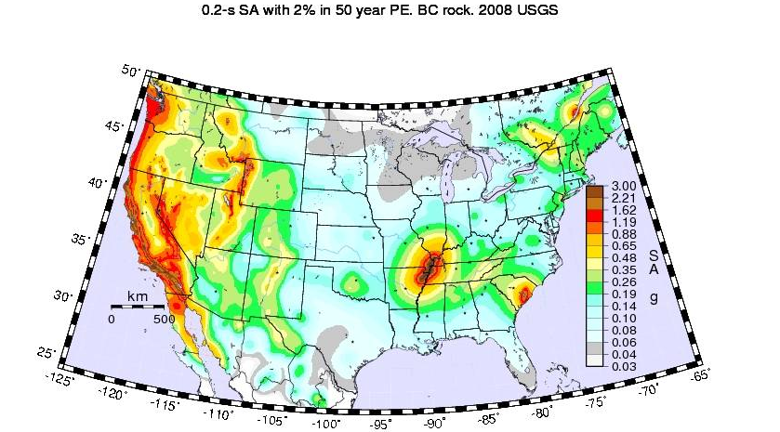
Probabilistic Seismic Hazard Maps
e.g., ground motion intensity with a uniform
1/2500 annual probability of being exceeded
Indian Institute of Science (IISc) Department of Civil Engineering Seminar
“New Risk-Targeted Seismic Maps Introduced into USA Building Codes,” N. Luco, USGS March 6, 2013

Slide 11
Past Seismic Design Approaches
Although seismic safety was implied by these past design approaches, …
… the seismic risk for the resulting structures …
(e.g., annual probability of seismically-induced failure)
… was not explicitly quantified in the design process, or in the development of the design process by regulators.
Indian Institute of Science (IISc) Department of Civil Engineering Seminar
“New Risk-Targeted Seismic Maps Introduced into USA Building Codes,” N. Luco, USGS March 6, 2013

Slide 12
Seismic Risk Quantification
Meanwhile, for decades now (e.g., ATC 3-06, 1978) …
Earthquake
Scientists
Earthquake
Engineers
Probabilistic Seismic
Hazard Curves
Probabilistic Seismic
Fragility Curves
Seismic
Risk
Indian Institute of Science (IISc) Department of Civil Engineering Seminar
“New Risk-Targeted Seismic Maps Introduced into USA Building Codes,” N. Luco, USGS March 6, 2013
Notes:
… earthquake engineers and scientists have worked together to quantify the seismic risk for existing structures.
This is done by coupling probabilistic ground shaking hazard results (at a wide range of hazard levels) from earthquake scientists with probabilistic structural performance assessments from engineers, e.g., …

Slide 13
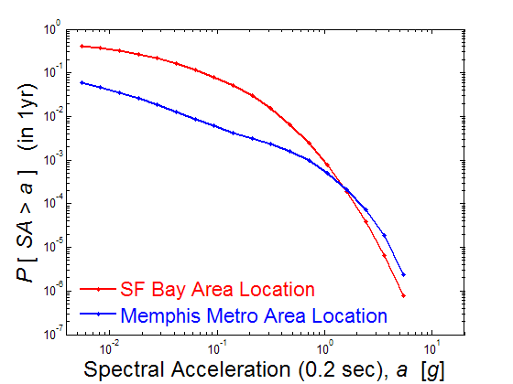
Probabilistic Seismic Hazard Curves
Results of Probabilistic Seismic Hazard Analysis (PSHA), pioneered by the late Prof. C. Allin Cornell in 1968.
Notes:
Hazard curves are interpolated to derive aforementioned “hazard maps”.
Shapes of hazard curves can vary significantly with location.
Annual Prob. of Exceedance
Ground Motion Intensity
Indian Institute of Science (IISc) Department of Civil Engineering Seminar
“New Risk-Targeted Seismic Maps Introduced into USA Building Codes,” N. Luco, USGS March 6, 2013
Notes:
* For these two locations, the 1/2500-yr ground motions are roughly equal.

Slide 14
Probabilistic Seismic Fragility Curves
Based on the performance of similar structures in past earthquakes, and/or numerical simulations.
Notes:
Fragility curve depends on the ground motion intensity for which the structure was designed (“Design IM”).
It also depends on the prescriptive requirements that are used to design the structure (e.g., those for buildings vs. nuclear power plants).
Indian Institute of Science (IISc) Department of Civil Engineering Seminar
“New Risk-Targeted Seismic Maps Introduced into USA Building Codes,” N. Luco, USGS March 6, 2013
Notes:
* These two example fragility curves are for generic buildings.

Slide 15
“Risk Integral”
Combination of such hazard and fragility curves is an application of the total probability theorem …
Risk
Fragility
Hazard
Indian Institute of Science (IISc) Department of Civil Engineering Seminar
“New Risk-Targeted Seismic Maps Introduced into USA Building Codes,” N. Luco, USGS March 6, 2013
Notes:
The combination of such hazard and fragility curves to quantify risk is often referred to, by earthquake engineers, as the risk integral, which is an application of the total probability theorem.

Slide 16
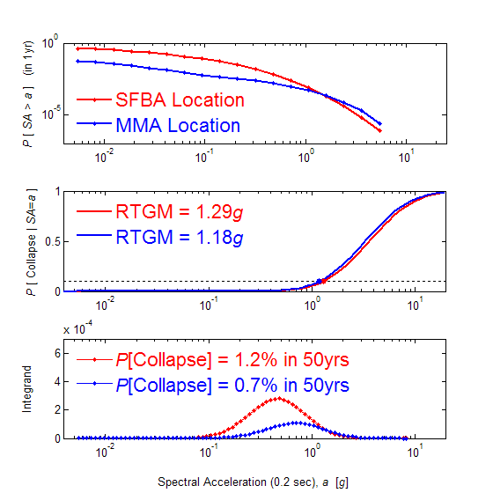

“Risk Integral” (Example)
Hazard
P [ IM > z ]
Design IM = 1.29g
Fragility
Design IM = 1.18g
P [ Collapse | IM=z ]
Risk
Integrand
Ground Motion Intensity, IM=z
Indian Institute of Science (IISc) Department of Civil Engineering Seminar
“New Risk-Targeted Seismic Maps Introduced into USA Building Codes,” N. Luco, USGS March 6, 2013

Slide 17
Risk-Based Design Approaches
Risk-Targeted Maximum Considered Earthquake (MCE_{R}) Ground Motions for designing new buildings and other structures, 2012 International Building Code
A Performance-Based Approach to Define the Site-Specific Earthquake Ground Motion, U.S. Nuclear Regulatory Commission (NRC) Regulatory Guide (RG) 1.208, 2007
Development of Next-Generation Performance-Based Seismic Design Procedures for New and Existing Buildings, Applied Technology Council (ATC) Project #58, funded by U.S. Federal Emergency Management Agency (FEMA), 2012
Indian Institute of Science (IISc) Department of Civil Engineering Seminar
“New Risk-Targeted Seismic Maps Introduced into USA Building Codes,” N. Luco, USGS March 6, 2013

Slide 18
2012 International Building Code
FIGURE 1613.3.1 RISK-TARGETED MAXIMUM CONSIDERED EARTHQUAKE (MCE_{R}) GROUND MOTION …
Indian Institute of Science (IISc) Department of Civil Engineering Seminar
“New Risk-Targeted Seismic Maps Introduced into USA Building Codes,” N. Luco, USGS March 6, 2013

Slide 19
“Risk Integral” (Example)
Hazard
P [ IM > z ]
Design IM = 1.29g
Fragility
Design IM = 1.18g
P [ Collapse | IM=z ]
Risk
Integrand
Ground Motion Intensity, IM=z
Indian Institute of Science (IISc) Department of Civil Engineering Seminar
“New Risk-Targeted Seismic Maps Introduced into USA Building Codes,” N. Luco, USGS March 6, 2013

Slide 20
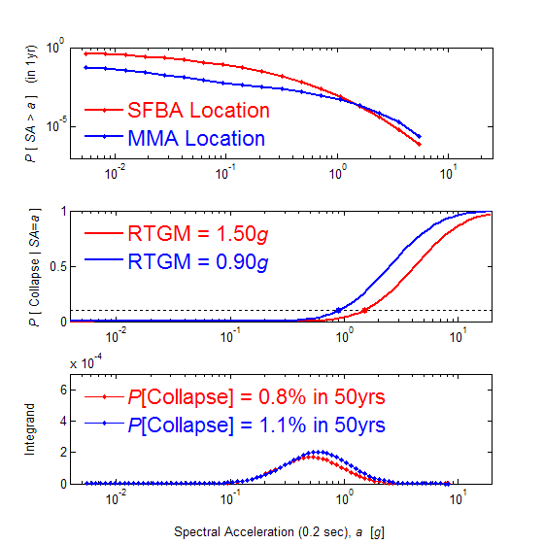
Risk-Targeted Ground Motions
Hazard
P [ IM > z ]
D
Design IM = 1.50g
2
D
Fragility
P [ Collapse | IM=z ]
Design IM = 0.90g
2
Risk
Integrand
Ground Motion Intensity, IM=z
Indian Institute of Science (IISc) Department of Civil Engineering Seminar
“New Risk-Targeted Seismic Maps Introduced into USA Building Codes,” N. Luco, USGS March 6, 2013

Slide 21
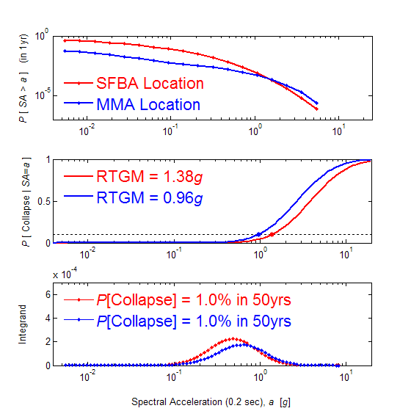
Risk-Targeted Ground Motions
Hazard
P [ IM > z ]
D
Design IM = 1.38g
D
Fragility
P [ Collapse | IM=z ]
Design IM = 0.96g
Risk
Integrand
Ground Motion Intensity, IM=z
Indian Institute of Science (IISc) Department of Civil Engineering Seminar
“New Risk-Targeted Seismic Maps Introduced into USA Building Codes,” N. Luco, USGS March 6, 2013

Slide 22
Risk-Targeted Ground Motions
“Guess” RTGM_{i}
Generate fragility curve as a function of RTGM_{i}
Integrate fragility & hazard curves to calculate risk
For a given location …
P[Collapse] in 50yrs
= 1%?
No
Yes
RTGM Calculated
Indian Institute of Science (IISc) Department of Civil Engineering Seminar
“New Risk-Targeted Seismic Maps Introduced into USA Building Codes,” N. Luco, USGS March 6, 2013

Slide 23
Risk-Targeted GM Maps
Note: RTGM maps are coupled with deterministic GM maps to produce the MCE_{R} GM maps in the 2012 IBC
Indian Institute of Science (IISc) Department of Civil Engineering Seminar
“New Risk-Targeted Seismic Maps Introduced into USA Building Codes,” N. Luco, USGS March 6, 2013
Notes:
Since this calculation of RTGMs is not straightforward, although it is in comparison to PSHA, the site-specific procedures include a second simpler method of calculating RTGMs, …

Slide 24
Risk Coefficients (C_{R}’s)
Conventional uniform-hazard (2500-yr) GMs interpolated from hazard curves
C_{R}’s =
e.g.,
  Risk-Targeted GMs
  Uniform-Hazard GMs
 | SFBA Location | MMA Location
Risk-Targeted GM | 1.38g | 0.96g
Uniform-Hazard GM | 1.29g | 1.18g
Risk Coefficient (C_{R}) | 1.07 | 0.82
Indian Institute of Science (IISc) Department of Civil Engineering Seminar
“New Risk-Targeted Seismic Maps Introduced into USA Building Codes,” N. Luco, USGS March 6, 2013

Slide 25
Risk Coefficient (C_{R}) Maps
Indian Institute of Science (IISc) Department of Civil Engineering Seminar
“New Risk-Targeted Seismic Maps Introduced into USA Building Codes,” N. Luco, USGS March 6, 2013

Slide 26
Risk Coefficient (C_{R}) Maps
< 0.85
Indian Institute of Science (IISc) Department of Civil Engineering Seminar
“New Risk-Targeted Seismic Maps Introduced into USA Building Codes,” N. Luco, USGS March 6, 2013

Slide 27
Risk Coefficient (C_{R}) Maps
> 1.15
Indian Institute of Science (IISc) Department of Civil Engineering Seminar
“New Risk-Targeted Seismic Maps Introduced into USA Building Codes,” N. Luco, USGS March 6, 2013

Slide 28
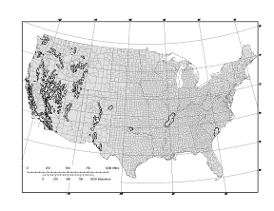
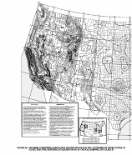
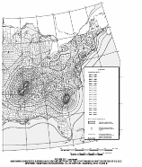
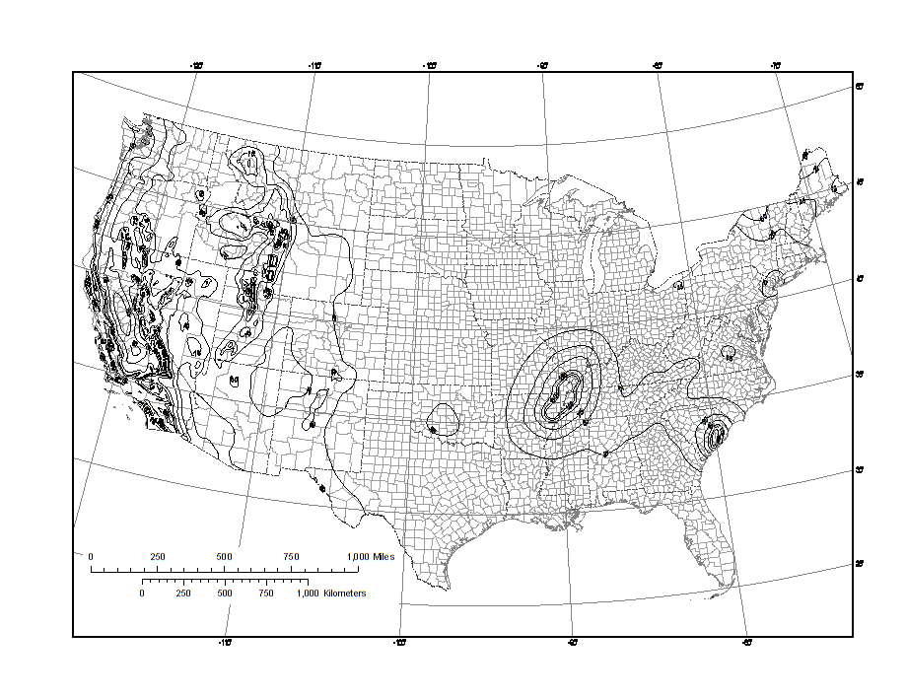
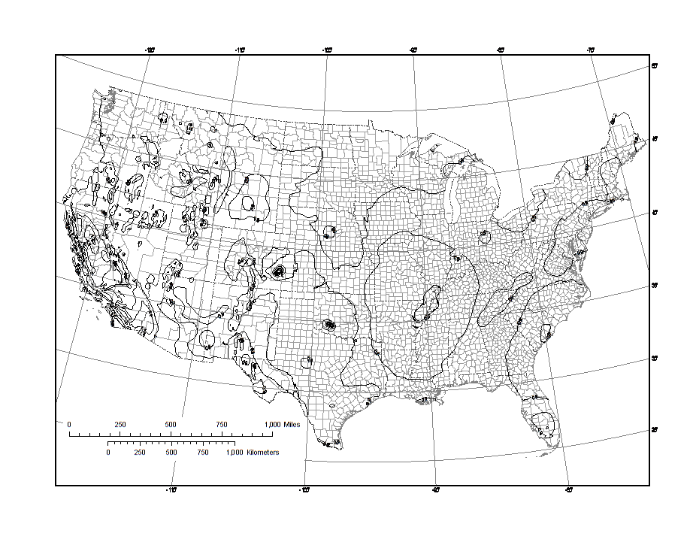
Preparation of New Design Maps
Probabilistic GMs
(Risk-Targeted)
Deterministic GMs
New MCE_{R} GMs
Uniform-Hazard GMs
Risk Coefficients
To relate back
to conventional uniform-hazard (2500-yr) GMs …
X
─ In ASCE 7-10
─ In 2009 NEHRP
Indian Institute of Science (IISc) Department of Civil Engineering Seminar
“New Risk-Targeted Seismic Maps Introduced into USA Building Codes,” N. Luco, USGS March 6, 2013

Slide 29

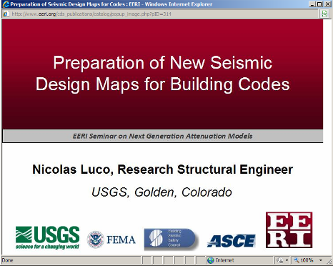
Google “EERI NGA Seminar Presentations” for Video
or email nluco@usgs.gov for just PowerPoint

Slide 30
Summary
Previous uniform-hazard (2%-in-50yr) probabilistic ground motions …
  Resulted in spatially-variable collapse risk, due to variations in hazard curve shapes
  Considered only a single selected point (2%-in-50yr) on hazard curves
  Were similar in value in Memphis Metro Area and San Francisco Bay Area
New risk-targeted probabilistic ground motions address these issues
Indian Institute of Science (IISc) Department of Civil Engineering Seminar
“New Risk-Targeted Seismic Maps Introduced into USA Building Codes,” N. Luco, USGS March 6, 2013
Notes:
Probabilistic hazard curves from which hazard maps are interpolated.

Slide 31
Summary (continued)
New risk-targeted probabilistic ground motions (RTGMs) …
  Explicitly & uniformly target 1% probability of collapse in a building’s lifetime, ~50 years
  Consider all points on & spatial variations in shapes of hazard curves
  Require a generic fragility that depends on RTGM & effectively considers shapes of hazard curves
  Changes uniform-hazard (2%-in-50yr) ground motions by factor of 0.85-1.15 generally, but as low as 0.70 near New Madrid and Charleston
Indian Institute of Science (IISc) Department of Civil Engineering Seminar
“New Risk-Targeted Seismic Maps Introduced into USA Building Codes,” N. Luco, USGS March 6, 2013
Notes:
Probabilistic hazard curves from which hazard maps are interpolated.

Slide 32
U.S. NRC RG 1.208 (2007)
“Target Risk” = 10⁻⁵ annual probability of Onset of Significant Inelastic Deformation (conservative w.r.t. structural failure)
Design IM presented as …
where Design Factor is
and
Annual Prob. of Exceedance
Ground Motion Intensity, IM
Indian Institute of Science (IISc) Department of Civil Engineering Seminar
“New Risk-Targeted Seismic Maps Introduced into USA Building Codes,” N. Luco, USGS March 6, 2013
Notes:
Specified tolerable seismic risk level is a …
Design ground shaking intensities presented as …the product of 10-4/year “uniform-hazard” intensities and an approximate design factor given by … where AR is the hazard curve slope (between hazard levels of 10-4 and 10-5/year).
Remove response spectrum

Slide 33
ATC-58 Project (funded by FEMA)
In addition to building collapse, these new design procedures target annual probabilities of earthquake-induced …
  casualties (Deaths),
  repair costs (Dollars), and
  loss of use (Downtime)
… via generalizations of the risk integral.
Furthermore, risk quantification is “high-resolution,” i.e., …
… fragility curve depends on details of individual elements of the building, not just the design ground motion intensity
Indian Institute of Science (IISc) Department of Civil Engineering Seminar
“New Risk-Targeted Seismic Maps Introduced into USA Building Codes,” N. Luco, USGS March 6, 2013
Notes:
Moreover, the resolution of the procedures is such that the fragility curves they quantify depend on details of individual elements of the building of interest (e.g., column dimensions), not just the design ground shaking intensity.
With this approach, the seismic design of buildings will be directly based on risk that is quantified in terms that owners and regulators can relate to.

Slide 34
Risk-Based Design Approaches
Seismic Design
of New Structures
Risk-Based Design
Seismic Risk Quantification
for Existing Structures
Indian Institute of Science (IISc) Department of Civil Engineering Seminar
“New Risk-Targeted Seismic Maps Introduced into USA Building Codes,” N. Luco, USGS March 6, 2013
Notes:
* Until recently, the engineering design of new structures to resist earthquakes, and the quantification of seismic risk for existing structures, had been relatively unconnected topics within earthquake engineering.

Slide 35
Implications
Tolerable seismic risk has now been specified quantitatively (vs. qualitative “safe”), which in turn impacts, e.g., …
  evaluation and retrofit of existing structures,
  design for other hazards (e.g., wind, rock falls), and
  prescriptive design procedures (e.g., selection and modification of ground motion time series for structural response simulations).
Risk-based approaches might eventually allay the need for prescriptive design procedures altogether.
Indian Institute of Science (IISc) Department of Civil Engineering Seminar
“New Risk-Targeted Seismic Maps Introduced into USA Building Codes,” N. Luco, USGS March 6, 2013

Slide 36
Outstanding Issues
Acceptable/tolerable risk level?
  once in terms of deaths/dollars/downtime, might be borrowed from other hazards?
  for individual structures and aggregation/region?
  must it be geographically uniform?
Validation of risk modeling/quantification (vs. reality)
  hazard and fragility components/curves
  data very scarce at large ground motion intensities
Indian Institute of Science (IISc) Department of Civil Engineering Seminar
“New Risk-Targeted Seismic Maps Introduced into USA Building Codes,” N. Luco, USGS March 6, 2013

